Slide 1
ARM926EJ-S
2007.1.29
gtlee

Slide 2
목차
ARM926EJ-S의 구성
ARM9EJ-S
Cache
MMU
BUS Interface
Coprocessor
TCM
ETM
EmbeddedICE-RT
MultiICE
JTAG

Slide 3
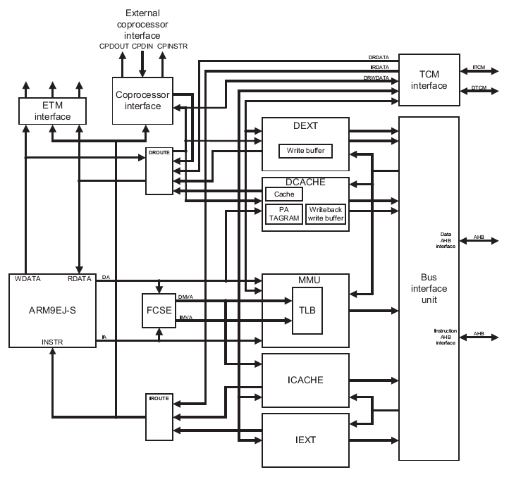
ARM926EJ-S Block Diagram

Slide 4
Macrocells
ARM9EJS | This is the processor core.
a926ejsBIU | This is the AHB Bus Interface Unit (BIU).
a926ejsClkBlk | This contains the clock control logic.
a926ejsCP15 | This contains the system control processor and external coprocessor interface.
a926ejsDCache | This is the data cache controller.
a926ejsDExt | This is the control block for external data accesses.
a926ejsDRoute | This is the data routing block between the ARM926EJSCore modules and the ARM9EJS module.
a926ejsETMIF | This is the Embedded Trace Macrocell (ETM) interface block.
a926ejsICache | This is the instruction cache controller.
a926ejsIExt | This is the control block for external instruction accesses.
a926ejsIRoute | This is the instruction routing block between the ARM926EJSCore modules and the ARM9EJS module.
a926ejsMMU | This is the Memory Management Unit (MMU).
a926ejsSysCtl | This is the system controller logic.
a926ejsTCM | This is the Tightly-Coupled Memory (TCM) controller.
EmbeddedICE-RT | This is the embedded debugging logic for the MultiICE.

Slide 5
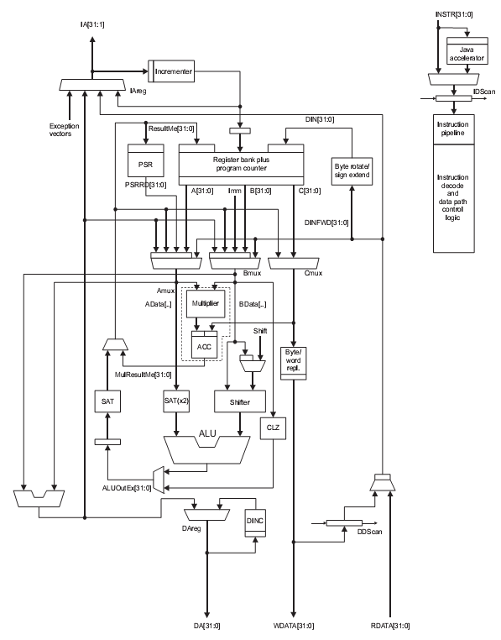
ARM9EJ-S
Little/Big endian
Seven operation mode
  User mode
  Fast interrupt mode
  Interrupt mode
  Supervisor mode
  Abort mode
  System mode
  Undefined mode
37 registers
  31 general purpose 32bit registers
  6개의 32bit status register
Three Processor operating state
  ARM state
  Thumb state
  Jazelle state
Supported Instructions
  32bit ARM instruction
  16bit Thumb instruction
Java byte codes
System control coprocessor(CP15)
  With ID code register
  With Cache and MMU control register

Slide 6
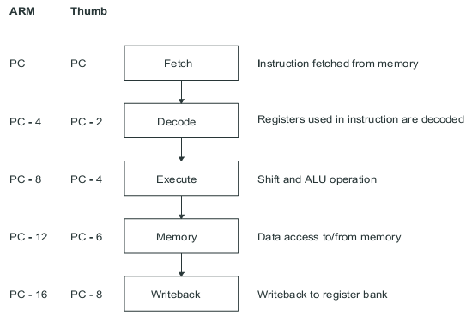
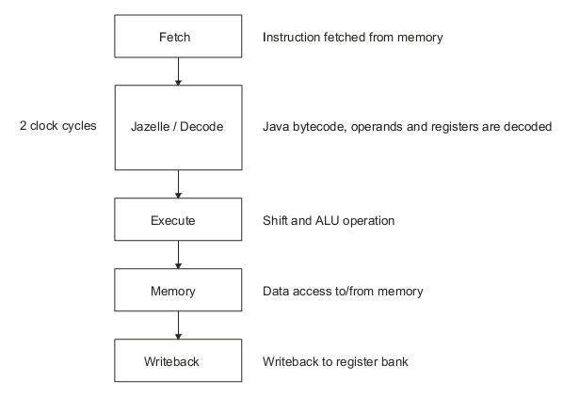
ARM9EJ-S : Pipeline
Six stage Jazelle pipeline
Five stage ARM, Thumb pipeline

Slide 7
ARM9EJ-S : Operating State
3 operating state
  ARM state : 32bit, word aligned instruction을 수행.
  Thumb state : 16bit, half word aligned instruction을 수행.
  Jazelle state : variable length, byte aligned instruction을 수행.
Switching state
  ARM ↔ Thumb : BX, BLX 명령을 이용.
  ARM ↔ Jazelle : BXJ 명령을 이용.
Exception
  ARM state에서 service routine을 수행.

Slide 8
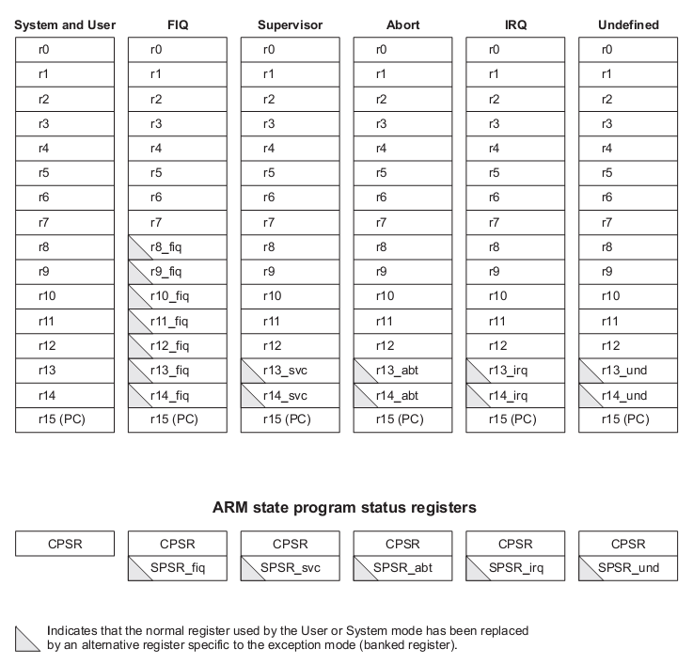
ARM9EJ-S : ARM Registers
General register의 special 용도
  R15 : Program counter
  R14 : Link register
  R13 : Stack pointer
Mode에 따라 물리적으로 독립된 register가 사용되는 register
  SP, LR
  SPSR

Slide 9
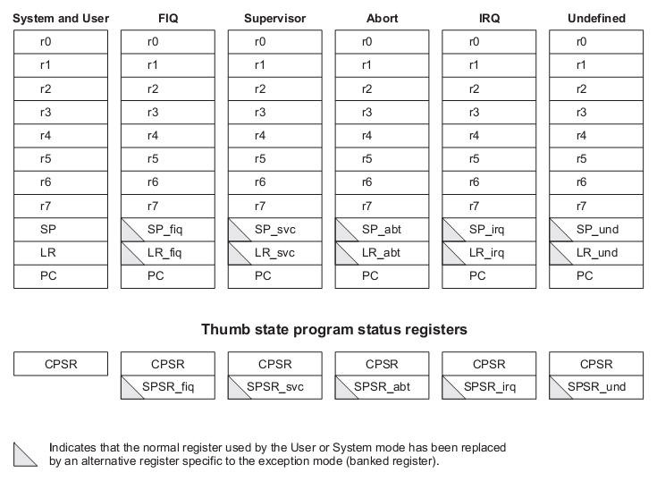
ARM9EJ-S : Thumb Registers
ARM state와의 대응
  R0~R7 : R0~R7
  SP : R13
  LR : R14
  PC : R15
R9-R15에 대응되는 high register를 access할 수 있는 instruction
  MOV : low register와 high register의 data를 교환.
  CMP : low register와 high register를 비교.
  ADD : high register의 값을 low register에 더함.

Slide 10
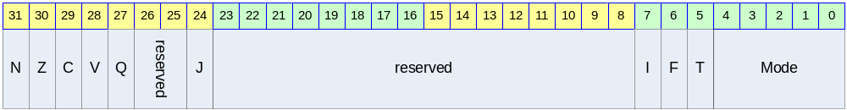
ARM9EJ-S : Status Register
N,Z,C,V flag
  - 최근의 연산 결과.
  - Thumb state에서는 branch 명령에서만 참조.
Q flag
  - Sticky overflow : saturation, signed overflow 등을 표현.
  - certain multiply와 fraction arithmetic 명령어.
J flag
  - Jazelle state를 나타냄.
I, F flag
- Interrupt enable/disable
T flag
  - Thumb state를 나타냄.
Mode Flags
  - Processor의 모드를 나타냄.
M[4:0] | Mode
10000b | User
10001b | FIQ
10010b | IRQ
10011b | Supervisor
10111b | Abort
11011b | Undefined
11111b | System

Slide 11
ARM9EJ-S : Exception Vectors
Exception | Offset | Mode on entry | I bit on entry | F bit on entry
Reset | 00h | Supervisor | Disabled | Disabled
Undefined instruction | 04h | Undefined | Disabled | Unchanged
Software interrupt | 08h | Supervisor | Disabled | Unchanged
Abort(prefetch) | 0Ch | Abort | Disabled | Unchanged
Abort(data) | 10h | Abort | Disabled | Unchanged
Reserved | 14h | Reserved | - | -
IRQ | 18h | IRQ | Disabled | Unchanged
FIQ | 1Ch | FIQ | Disabled | Disabled
Vector base address
  CFGHIVECS = 0 : 0000 0000h
  CFGHIVECS = 1 : FFFF 0000h
ARM Exception Vectors
  Exception service routine으로 branch하는 instruction.

Slide 12
ARM9EJ-S : Exception Priority
Exception Priority
  Reset(highest priority)
  Data Abort
  FIQ
  IRQ
  Prefetch Abort
  BKPT, Undefined instruction, and SWI(lowest priority)

Slide 13
ARM9EJ-S : Exception Entering/Leaving
Exception service routine으로 진입
  Next instruction의 주소를 LR에 저장한다.
  CPSR를 해당 mode의 SPSR로 복사.
  CPSR mode bit을 해당 mode로 설정.
  PC를 exception vector의 주소로 설정하여 다음 명령어를 fetch.
Exception service routine에서 복귀
  LR을 PC로 복사한다.
  S bit이 1이고, rd=r15이면, SPSR을 CPSR에 복사한다. 그리고 interrupt disable flag를 clear한다.

Slide 14
ARM9EJ-S : Exceptions
Reset
  nRESET 핀이 low로 driving 될 경우, processor는 reset.
  Reset 상태에서 nRESET 핀이 high로 driving 되면 다음과 같은 동작을 수행.
    CPSR의 mode bits을 supervisor mode(10011b)로 설정한다. I와 F flag를 set하여 interrupt를 disable한다. T와 J bit을 clear하여 ARM state로 설정한다.
    PC를 reset vector address로 설정한다.
    ARM state에서 명령어를 수행한다.
FIQ (Fast Interrupt reQuest)
  8개의 전용 register를 내장하여 interrupt 응답시간을 줄임.
  Privileged mode에서 F flag를 set하여 FIQ를 disable시킬 수 있음.
  IRQ와 FIQ 모두 disable.
IRQ (Interrupt ReQuest)
  FIQ보다 우선순위가 낮음.
  Privileged mode에서 I flag를 set하여 IRQ를 disable시킬 수 있음.
  IRQ는 disable.
Aborts
  memory operation은 완료되지 못 할 경우 발생.
    Prefetch Abort
    Data Abort

Slide 15
ARM9EJ-S : Exceptions
Prefetch Abort
  Instruction fetch fail.
  Instruction fetch의 마지막에 IABORT signal을 검사.
  prefetched instruction에 invalid라고 marking.
  invalid instruction이 execution stage에 도착했을 때 exception에 진입.
Data Abort
  Data load/store fail.
  data access cycle의 마지막에 체크.
  Access하는 address의 data가 유효하지 않다면, MMU는 Abort를 발생
  → 그러면 Abort exception handler는 abort의 원인을 분석하고, data를 유효하게 함
  → processor는 중단된 명령어를 재 시도.
SWI (SoftWare interrupt)
  Software interrupt instruction에 의해서 발생.
  supervisor mode로 진입하여 supervisor function의 수행을 요구하는데 사용.
  SWI handler는 opcode를 이용하여 SWI function 번호를 얻음.
  IRQ는 disable.
Undefined Instruction
  명령어를 확장하는데 사용.
  Handler는 해당 instruction의 특수한 function을 수행.
  IRQ는 disable.
BKPT
  Breakpoint instruction을 fetch하면 prefetch Abort를 발생.

Slide 16

Address types
MVA : Modified Virtual Address
  Virtual address의 상위에 Fast Context Switch Extension (FCSE) Process Identifier (PID)정보 7bit를 더해서 생성한 Virtual Address
  Context switching을 손쉽게 하기 위한 방법
  FCSE PID가 0이면 VA=MVA.
  최대 127개의 process만 사용가능.
  각 process는 Max 32Mbyte의 memory만 사용가능.

Slide 17
Cache
구성
  Instruction Cache
  Data Cache
Feature
  Size : 4kbyte ~ 128kbyte
  4 way
  One line is 32bytes
  Replace algorithm
    Pseudo-random
    Round-robin
  Support Write-through and Write-back modes
  Use the Virtual index and virtual tag
    The Dcache stores the Physical Tag for MMU is not involved at the write-back operation.

Slide 18
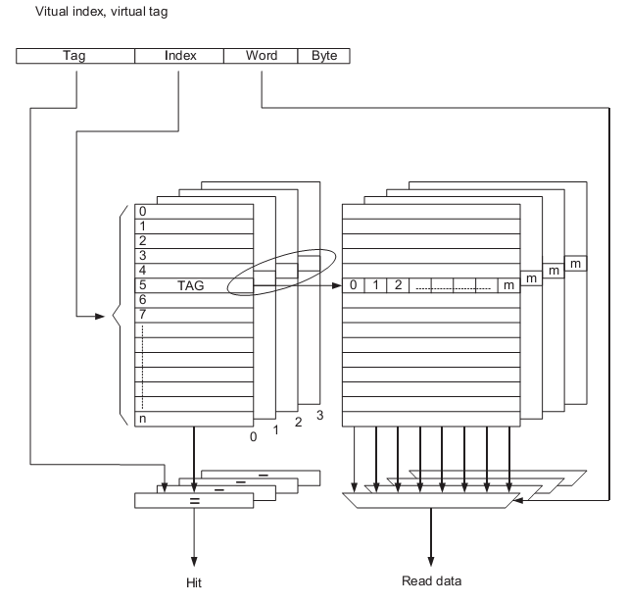
Cache Indexing

Slide 19
Data Write Buffer
Use area
  Noncachable
  Bufferable region
  Write through region
  Write miss to a write-back region
Spec
  Data buffer : 16 word
  4 address buffer

Slide 20
MMU
a single unified Translation Lookaside Buffer (TLB)
구성
  Main TLB
    2 way, total 64 entry.
  Lockdown TLB
    8 entry, fully associative.
Feature
  Support size, domain, protection
  Page size : section(1M), large page(64K), small page(4kB), tiny page(1kB)
  Large 와 small page는 quarter 단위로 access permission을 설정
  Section and tiny page have a single set of access permissions
  Hardware page table walks (hardware entry replace)

Slide 21
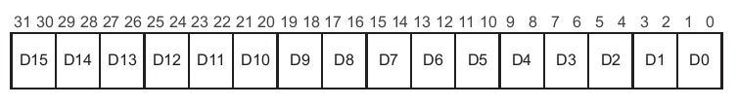
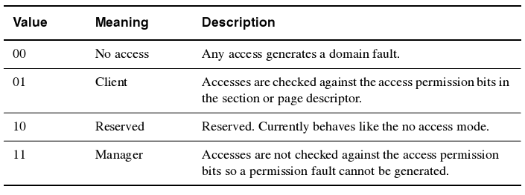
MMU : Domain
Domain : a primary access control mechanism
Domain Access Control Register : CP15 c3

Slide 22
MMU : Access Permission
AP | S | R | Privileged Permissions | User Permissions
00 | 0 | 0 | No access | No access
00 | 0 | 1 | Read-only | No access
00 | 1 | 0 | Read-only | Read-only
00 | 1 | 1 | Unpredictable | Unpredictable
01 | x | x | Read/Write | No access
10 | x | x | Read/Write | Read-only
11 | x | x | Read/Write | Read/Write
AP : Page table의 access permission
S,R : CP15 c1[9:8]

Slide 23

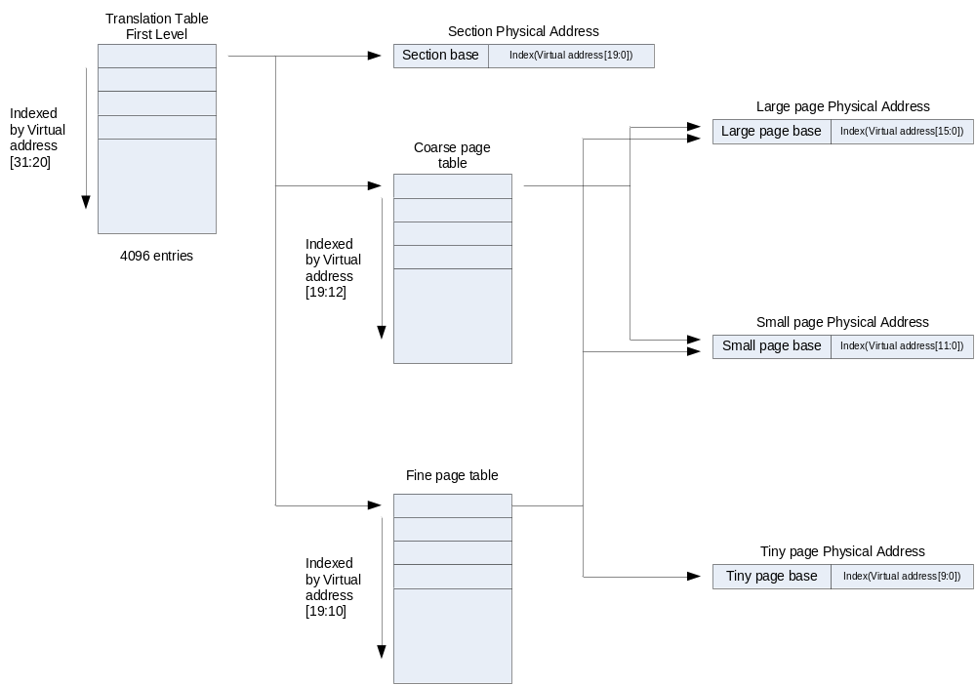
MMU : Translation Table
Base Register : CP15 c2
Table are Two Level.

Slide 24
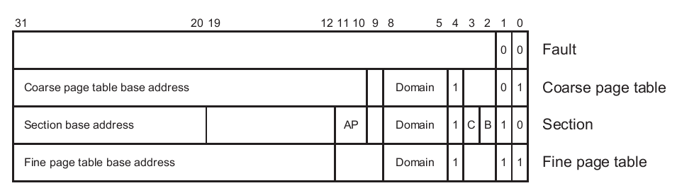
MMU : First Level Descriptor
First Level Descriptor
  AP : Access Permission bits
  Domain : Domain control bits
  C, B : Cache and write buffer control bits

Slide 25
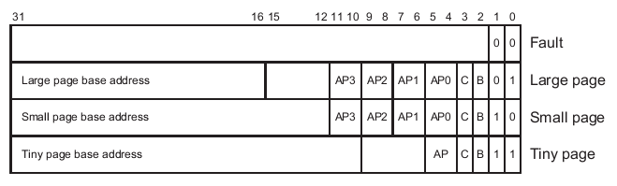
MMU : Second Level Descriptor
Second Level Descriptor
  AP0 ~ 3 : Access Permission

Slide 26
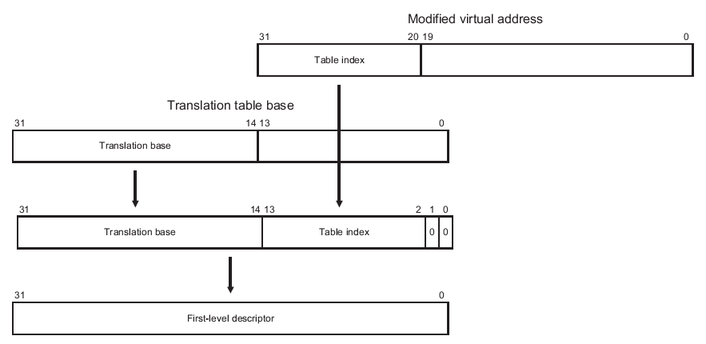
MMU : First Level Descriptor Address

Slide 27
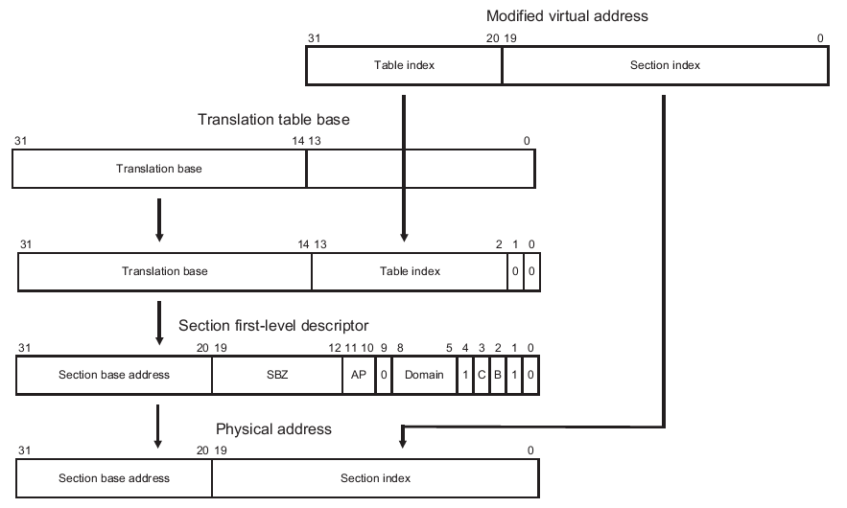
MMU : Section Translation

Slide 28
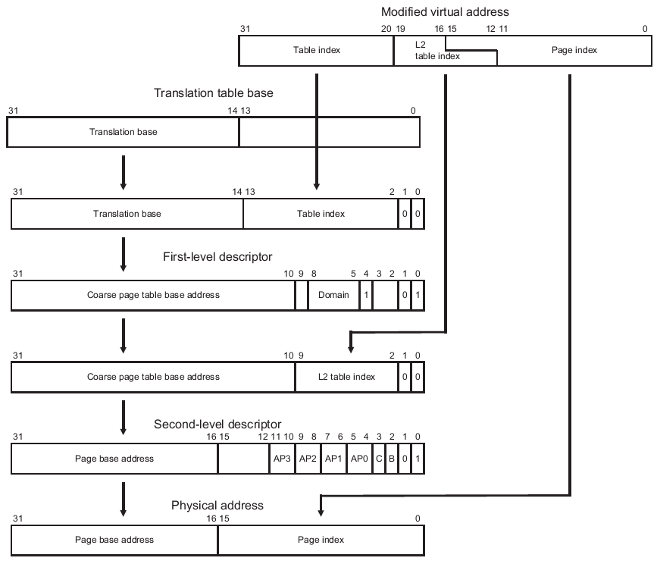
MMU : Large Page Translation

Slide 29
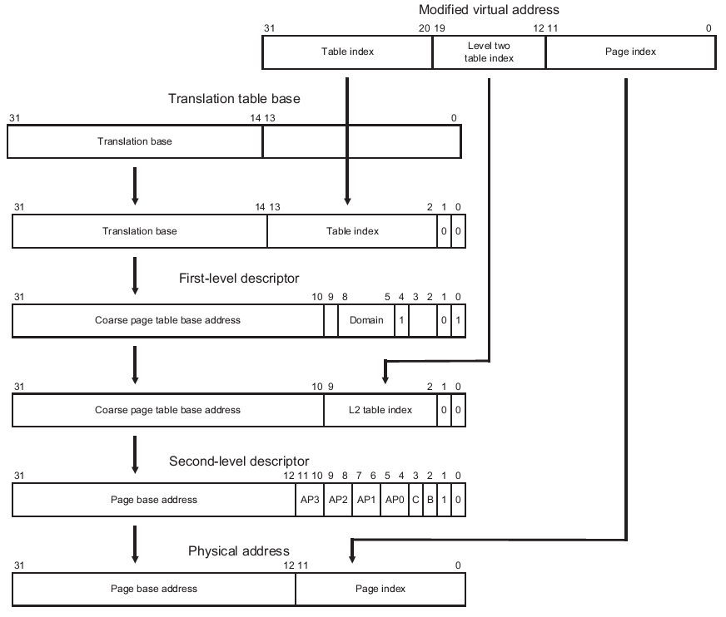
MMU : Small Page Translation

Slide 30
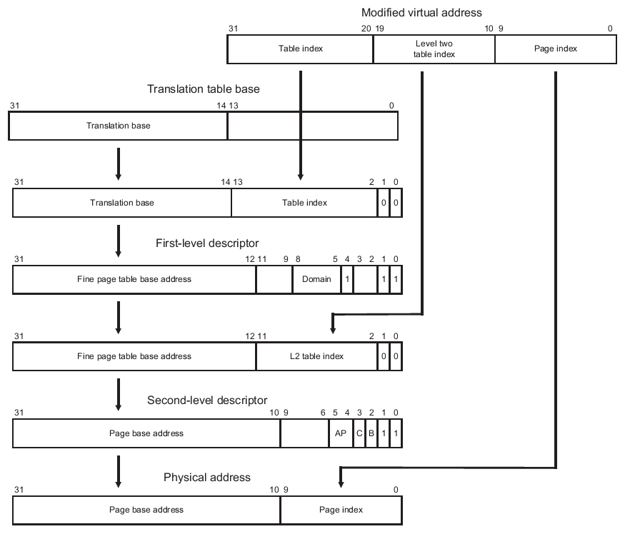
MMU : Tiny Page Translation

Slide 31
MMU : Exceptions
MMU Exception
  Alignment Faults
  Translation Faults
  Domain Faults
  Permission Faults
  External Aborts

Slide 32
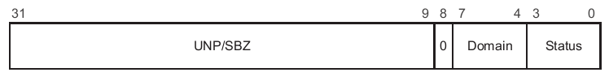
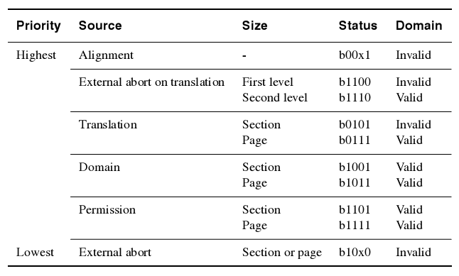
MMU : Fault Status Register
FSR
  Instruction FSR, Data FSR이 별도로 존재
  Domain : Fault가 발생한 Domain
  Status : Fault의 종류
Exception 우선순위 및 Status register value

Slide 33
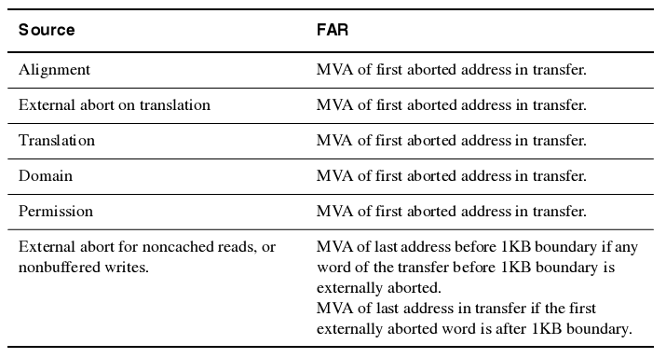
MMU : Fault Address Register
External abort시, 1kbyte page단위에서 마지막으로 abort가 방생한 주소를 저장

Slide 34
Bus Interface Unit(BIU)
Separate masters for both instruction and data access.
Use Transfer Mode
  Single
  Incr4
  Incr8
  Wrap8 : for cache

Slide 35
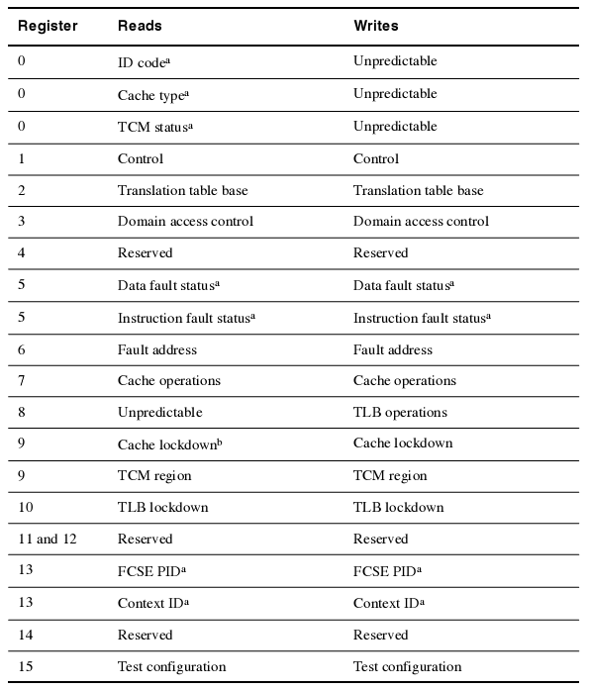
Coprocessor 15
System control coprocessor
: CP15

Slide 36
TCM
TCM : Tightly-Coupled Memory
  Low latency access.
  TCM region register(CP15 c9)에서 TCM의 physical address를 결정.
  Bootable from ITCM if assorted INITRAM pin.
  Contains a two entry write buffers

Slide 37
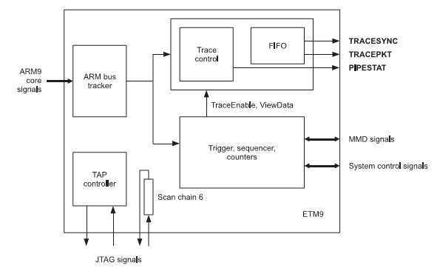
ETM
ETM : Embedded Trace Macrocell
Feature
  Real time instruction of ARM Trace
  Real time data of ARM Trace

Slide 38
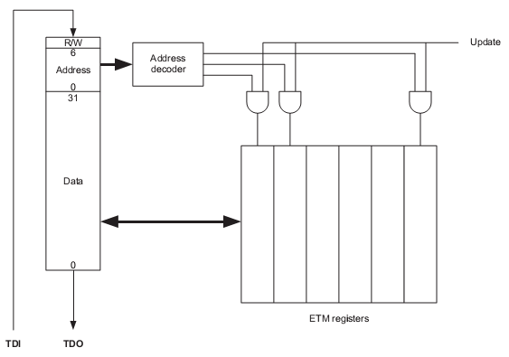
ETM : JTAG
JTAG scan chain : 40bits
  Read/write
  Address of ETM registers
  Data
JTAG Register
  Internal register : 55개
  FIFO : 9bit x 45 x 9

Slide 39
EmbeddedICE-RT : Feature
Feature
  Two breakpoint/watchpoint unit
    Address, data, control field로 구성
    각 field는 value, mask register로 구성
  JTAG Scan chain
    R/W : read or write 선택
    Address : target register를 선택
    Data : target register의 data

Slide 40
EmbeddedICE-RT : Registers
Address | Width | Function | Type
00000b | 6 | Debug control | Read/Write
00001b | 5 | Debug status | Read-only
00010b | 8 | Vector catch control | Read/Write
00100b | 6 | Debug communications control | Read-only
00101b | 32 | Debug communications data | Read/Write
01000b | 32 | Watchpoint 0 address value | Read/Write
01001b | 32 | Watchpoint 0 address mask | Read/Write
01010b | 32 | Watchpoint 0 data value | Read/Write
01011b | 32 | Watchpoint 0 data mask | Read/Write
01100b | 9 | Watchpoint 0 control value | Read/Write
01101b | 8 | Watchpoint 0 control mask | Read/Write
10000b | 32 | Watchpoint 1 address value | Read/Write
10001b | 32 | Watchpoint 1 address mask | Read/Write
10010b | 32 | Watchpoint 1 data value | Read/Write
10011b | 32 | Watchpoint 1 data mask | Read/Write
10100b | 9 | Watchpoint 1 control value | Read/Write
10101b | 8 | Watchpoint 1 control mask | Read/Write

Slide 41
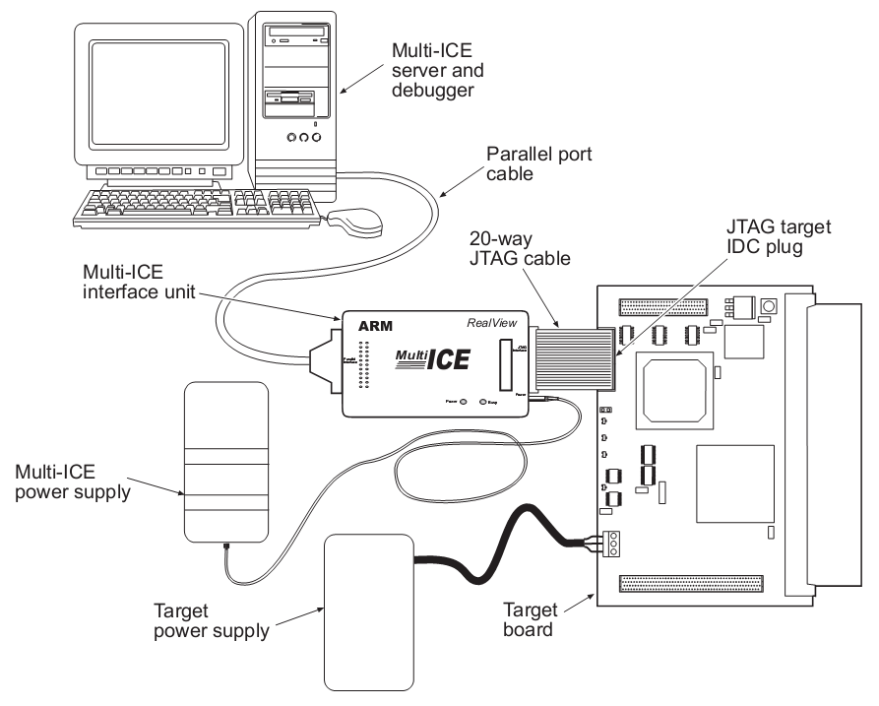
MultiICE
EmbeddedICE logic debug solution from ARM
Using JTAG
Using EmbeddedICE-RT and Support ETM

Slide 42
MultiICE signals
Signal Name | I/O | Description
VTref | I | Target reference voltage. RTCK와 TDO의 logic-level의 기준 전압을 알려준다.
Vsupply | I | MultiICE의 target보드쪽에서의 공급 전원.
nTRST | O | JTAG reset
TDI | O | JTAG data output to target cpu
TMS | O | JTAG test mode signal
TCK | O | JTAG JTAG test clock
RTCK | I | Return test clock
TDO | I | JTAG data input from target cpu
nSRST | I/O | All system is reset. 이 신호는 option으로 사용비중은 높으나 필수 신호는 아니다.
DBGRQ | O | Debug request. Not used in the MultiICE.
DBGACK | I | Debug acknowledge. Not used in the MultiICE.

Slide 43
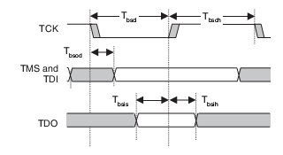
JTAG : Signals
TRST : JTAG reset. Negative active
TCK : JTAG clock. Rising edge에서 TDI와 TDO가 유효하다.
TDI : serial data input
TDO : serial data output
TMS : TAP controller state control signal

Slide 44
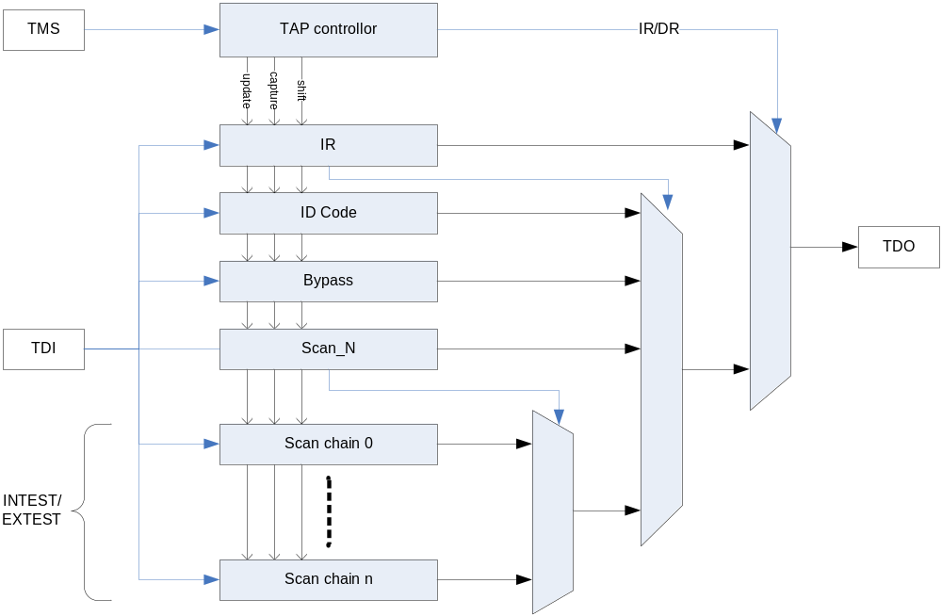
JTAG : 구성
JTAG의 구성
  TAP controller
  Instruction Register
  ID Code Register
  Bypass register
  Scan chains : IR이 INTEST/EXTEST에서 access.

Slide 45
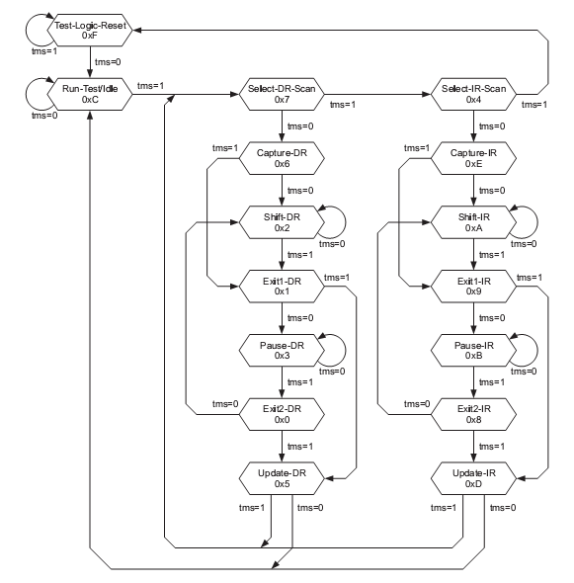
JTAG : Tap controller State
JTAG TAP controller의 state diagram
TMS의 값에 따라 state의 천이가 결정

Slide 46
JTAG : IR
Instruction Register
  JTAG의 동작을 결정한다.
  4bit로 구성.
  동작 및 register(IDCODE, BYPAS, SCAN_N)를 선택.
Instruction | Binary code | Hex code
EXTEST | 0000b | 0h
SAMPLE/PRELOAD | 0011b | 3h
SCAN_N | 0010b | 2h
INTEST | 1100b | Ch
IDCODE | 1110b | Eh
BYPASS | 1111b | Fh
RESTART | 0100b | 4h

Slide 47
JTAG : ID Code
ID Code Register
  Device identification code
  Port TAPID[31:0]
  Value is 0x07926F0F

Slide 48
JTAG : Scan path select register
Scan path select register
  IR이 SCAN_N일 때 update
  5bit register
  ARM의 scan chain을 선택
AEM9EJ-S Scan chain number | Function
0 | Reserved
1 | Debug
2 | EmbeddedICE-RT programming
3 | External boundary scan
4-15 | Reserved
15-31 | Unassigned

Slide 49
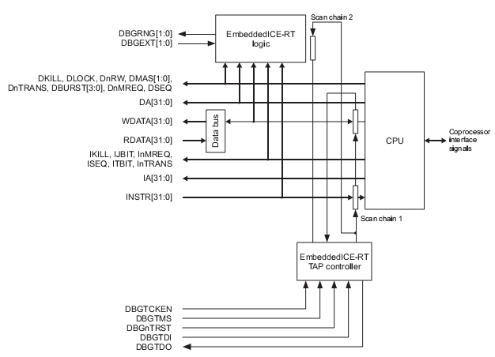
JTAG : ARM scan chain
Scan chain 1 : ARM의 instruction bus and data bus를 control.
Scan chain 2 : EmbeddedICE-RT의 register를 control.

Slide 50
JTAG : ARM Scan chain 1
Scan chain 1
  Communication between the debugger and the ARM926EJ-S core
  Width : 67 bits
  Control instruction and data bus.
  Send and receive data.
  Send ARM instruction.
Bit number | Function | R/W
[66:35] | RDATA/WDATA[0:31] | RW
[34] | Unused
[33] | WPTANDBKPT | W
[32] | SYSSPEED | W
[31:0] | Instruction[31:0] | W

Slide 51
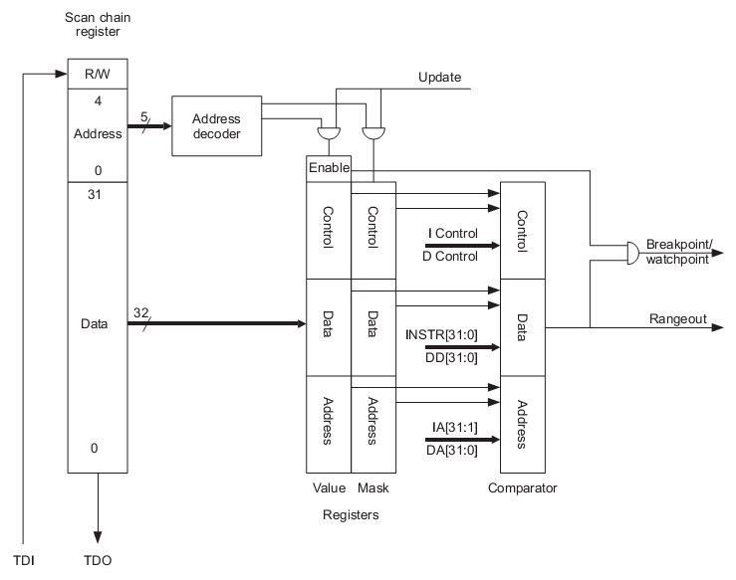
JTAG : ARM Scan chain 2
Scan chain 2
  access EmbeddedICE-RT registers.
  Width : 38 bits
Bit number | Function | R/W
[37] | Read/Write control | W
[36:32] | Address[4:0] | W
[31:0] | Data[31:0] | RW

Slide 52
JTAG : ARM Scan chain 6
Scan chain 6
  Access ETM registers
  40bits
Bit number | Function | R/W
[39] | Read/Write control | W
[38:32] | Address[6:0] | W
[31:0] | Data[31:0] | RW

Slide 53
JTAG : ARM Scan chain 15
Scan chain 15
  Access CP15 registers
  48bits
Bits | Function
[47] | 1 = Write 0 = Read
[46:44] | Opcode_1 of MRC/MCR instruction.
[43:41] | Opcode_2 of MRC/MCR instruction.
[40:37] | CRn of MRC/MCR instruction.
[36:33] | CRm of MRC/MCR instruction.
[32] | When written : 1 = initiate new access 0 = NOP When read : 1 = access complete 0 = access incomplete
[31:0] | Data value

